Slide 1

Slide 1
DATA BREWERIES
Presentation
PHILIP TRAXLER
ZACHARY HARRIS
LINDA URRUTIA

Slide 2
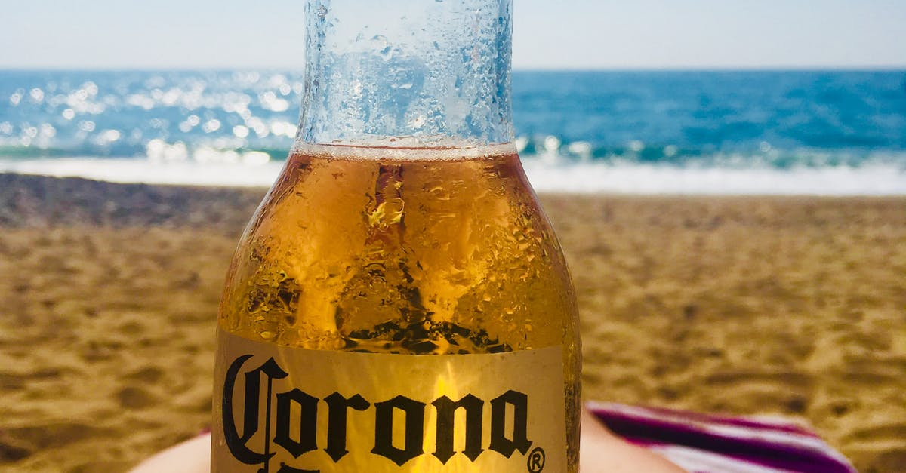
PRESENTATION ITEMS
Number of Breweries in the United States
Addressing missing values
Median alcohol content
Median international bitterness unit
State with the maximum alcoholic & most bitter beer
Alcohol by volume distribution
Summary stats and distribution of ABV variable
Scatter plot on apparent relationship between bitterness of beer and alcohol content
Additional methods used to investigate differences

Slide 3
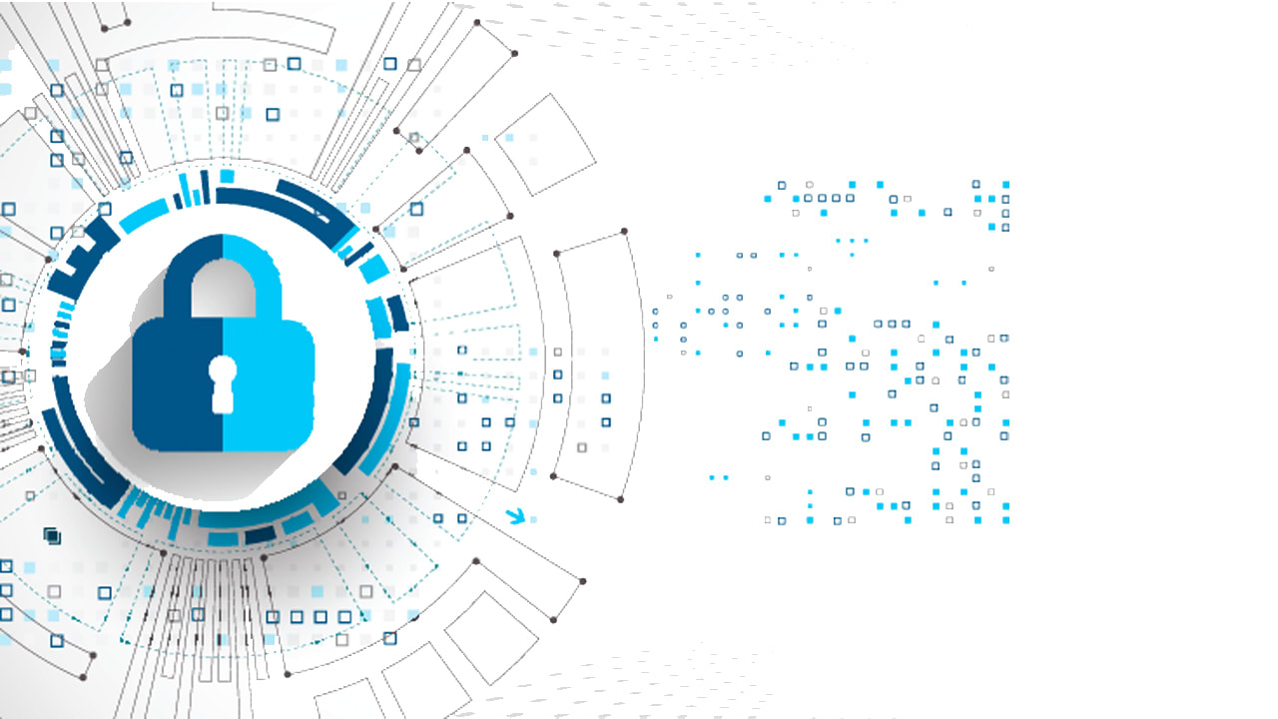
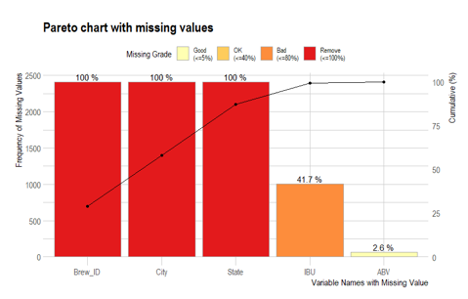
Slide 2
ADDRESSING MISSING VALUES
2
This Photo by Unknown Author is licensed under CC BY-SA-NC

Slide 4
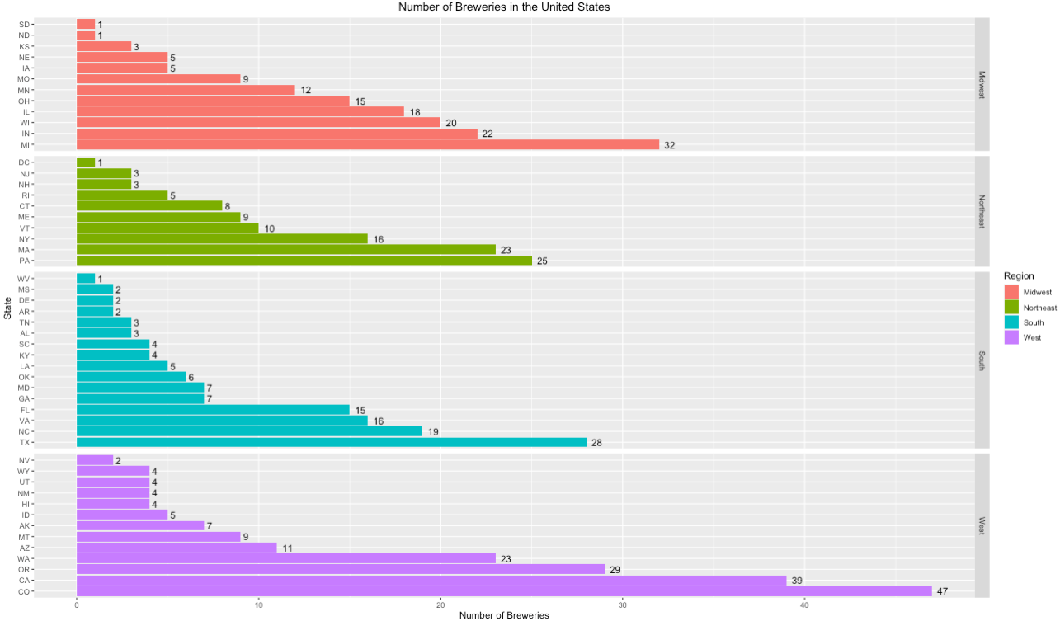
Slide 2
NUMBER OF BREWERIES IN THE U.S.
Here we can see the number of breweries by state as well as by U.S. region.
1

Slide 5
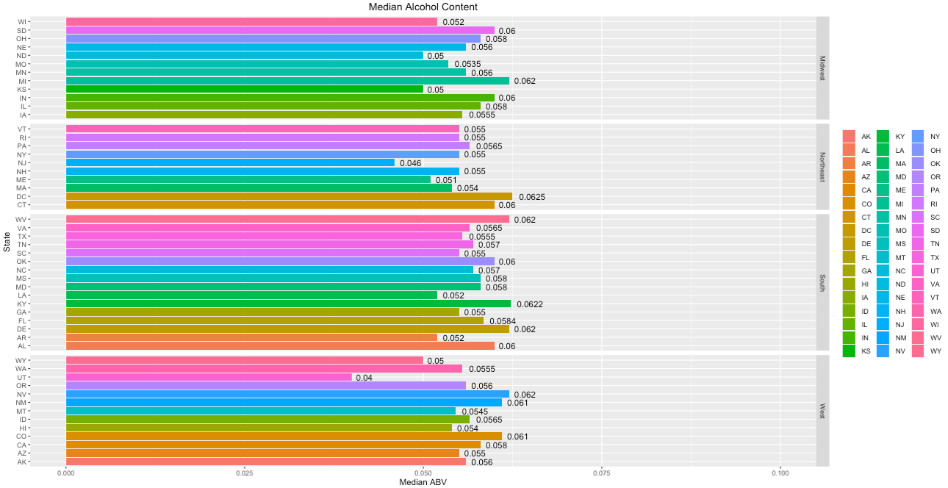
Slide 2
MEDIAN ALCOHOL CONTENT
3

Slide 6
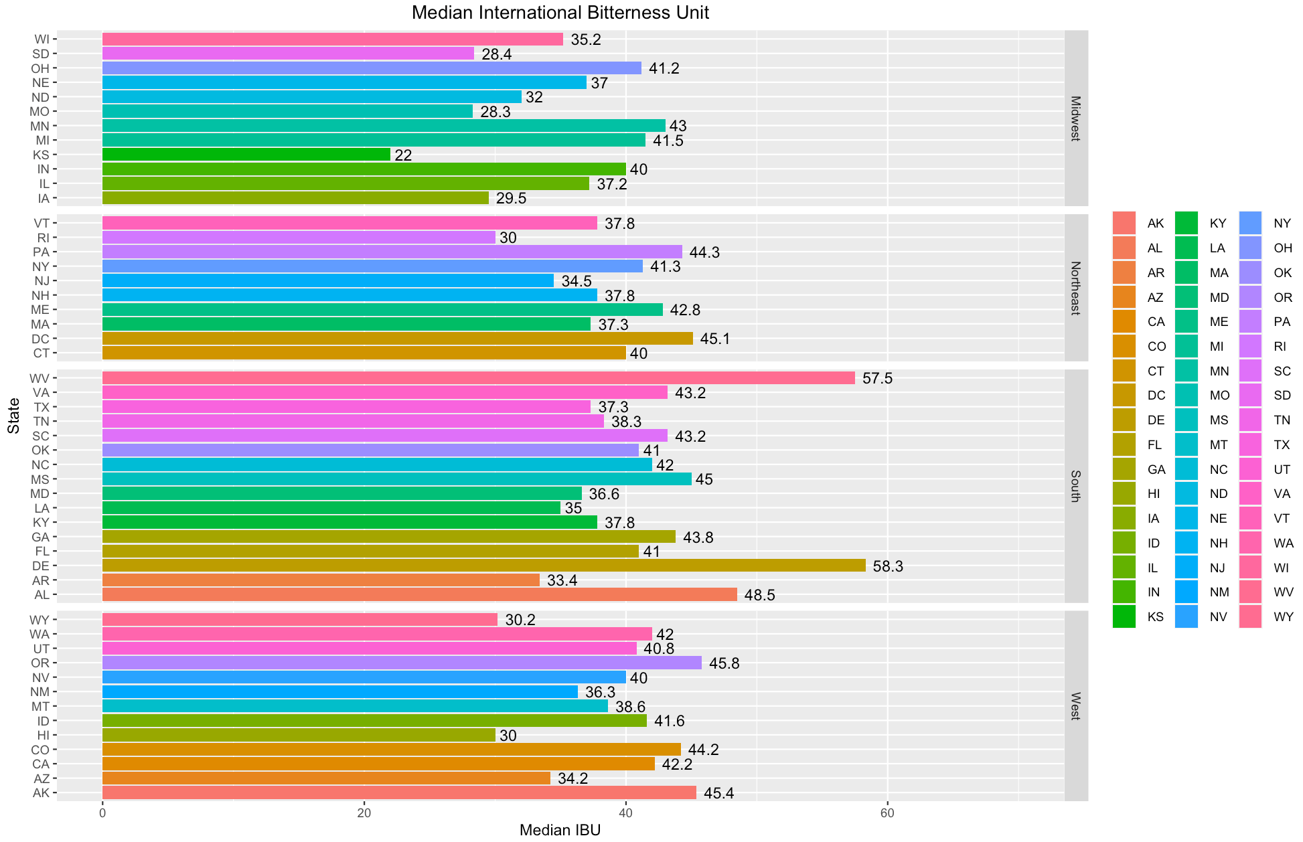
Slide 2
MEDIAN INTERNATIONAL BITTERNESS UNIT
4

Slide 7
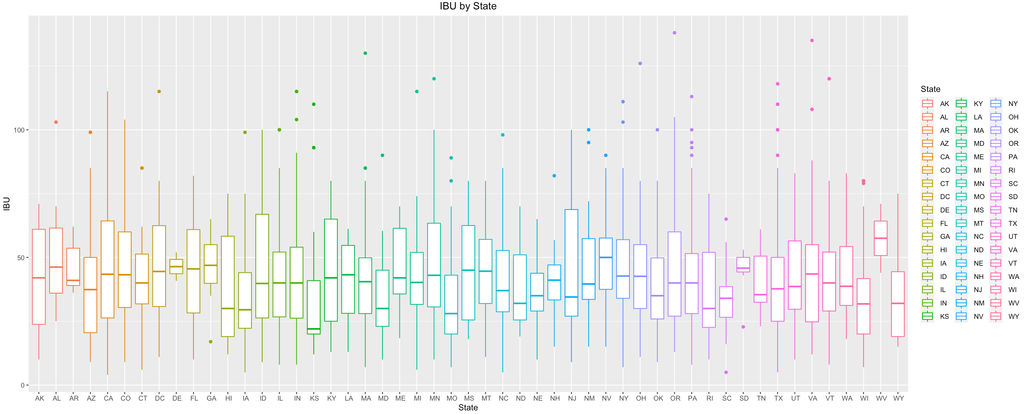
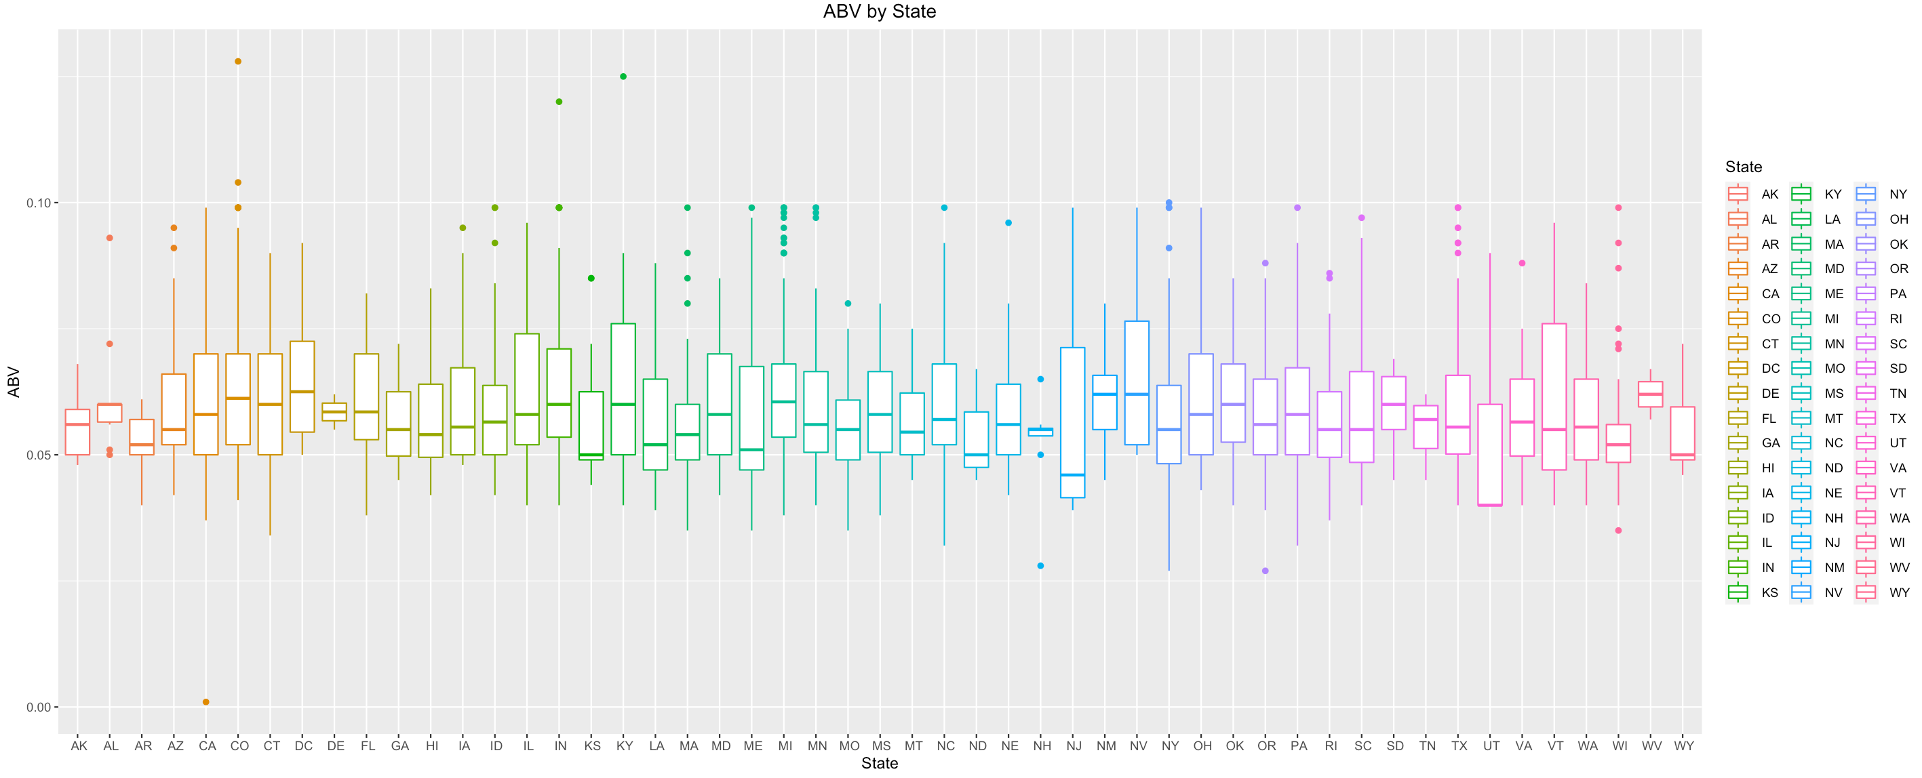
Slide 2
STATE WITH MAXIMUM ALCOHOLIC & MOST BITTER BEER
5

Slide 8
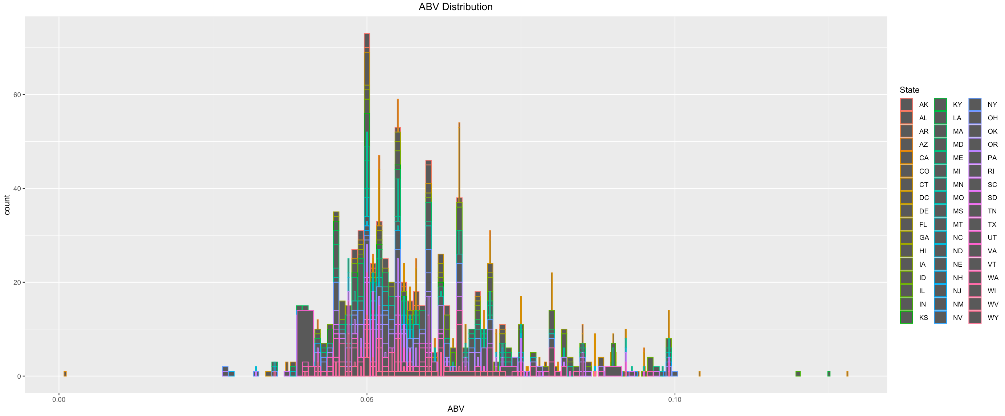
Slide 2
ALCOHOL BY VOLUME DISTRIBUTION
We can see that most beers are close to if not just above the ABV of Budweiser (5%).
6

Slide 9
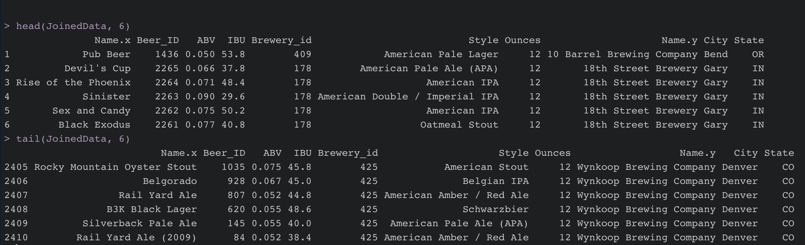
Slide 2
DATA SUMMARY
7

Slide 10
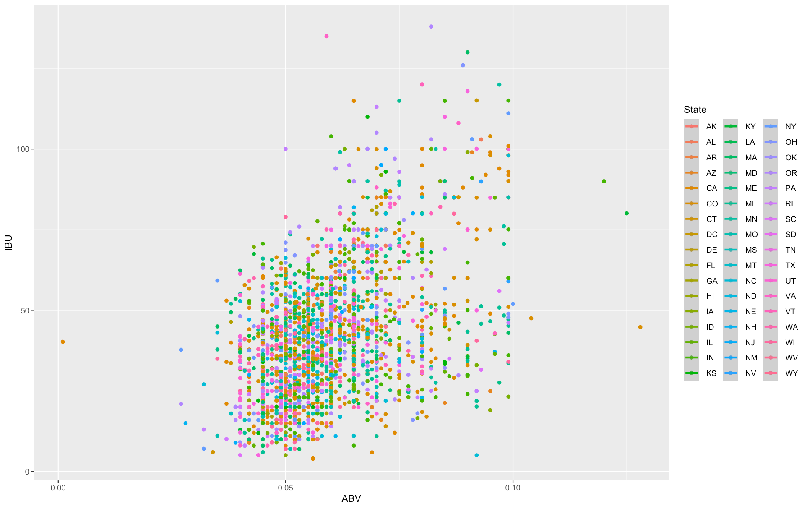
Slide 2
ABV VS IBU
Notice the positive and upward trend to the right. This delineates a positive trend.
2

Slide 11
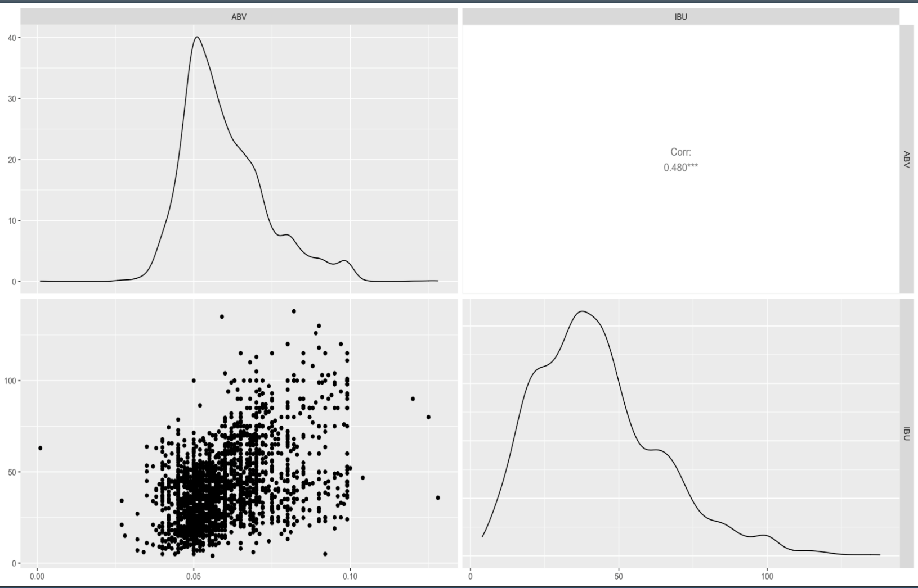
Slide 2
ABV & IBU RELATIONSHIP
Understanding that there is a correlation of .48, statistically, that is a semi-strong correlation.
Looking at the graph to the bottom left, we see that since many of the points are scattered toward the right side of the scatterplot, this would point us to further back the semi-strong sentiment of correlation.
8

Slide 12
Slide 2
kNN
Looking at the KNN classifier, we see that in order to maintain an accuracy of nearly 80%, we only need 5 other beers near the same ABV and IBU to determine weather or not the new beer is an Ale or IPA.
9

Slide 13
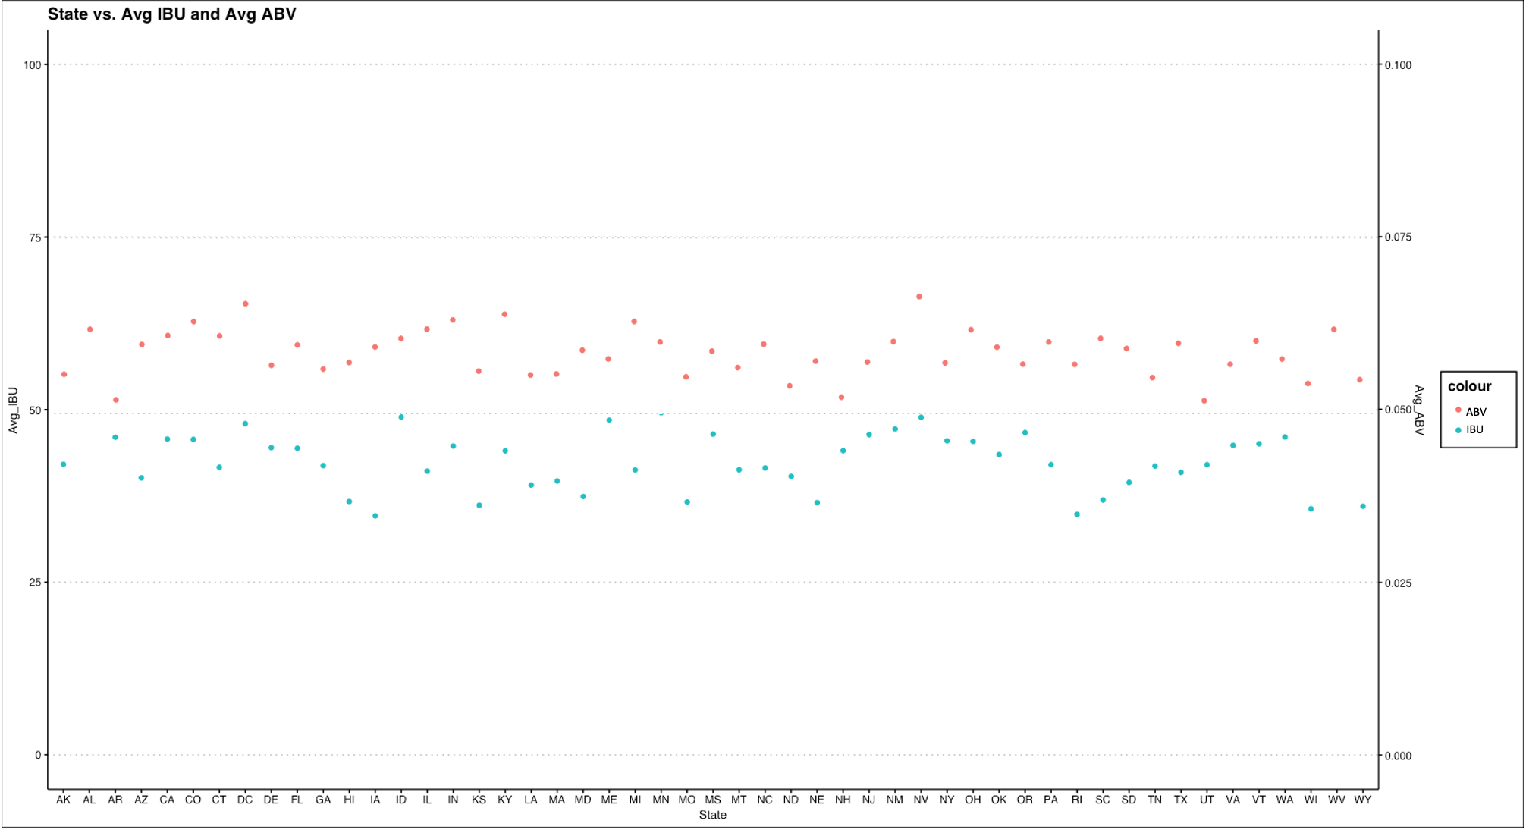
Slide 2
ABV & IBU RELATIONSHIP
13

Slide 14
Slide 1
Significant Libraries and Packages
library(dlookr)
library(visdat)
library(plotly)
library(missRanger)
library(ggplot2)
library(magrittr)
library(ranger)
library(dplyr)
library(class)
library(caret)
library(e1071)
library(GGally)
library(stringi)
library(stringr)
library(xgboost)
library(car)
library(Matrix)
library(keras)
library(forecast)
library(neuralnet)

Slide 15

Slide 11
THANK YOU

